Slide 1
Variations in Hospital Charge and Its Determinants
Capstone Project By: Amanuel Sidamo
Data Science Cohort 2
Nashville Software School
May,2019

Slide 2
Summary
With an aim to understand what explains variations in hospital charge for similar or same procedure, Medicare outpatient charge data is combined with hospital information data obtained from CMS website and visualized the charge data by state and by procedures and mapped by range of charge. Compared distribution of charge for different procedure types. The comparison shows inter state and intra state level variations in hospital charge. Complex and expensive procedures have more variations than simple or less expensive procedures.
Estimated models using different statistical models mainly Lasso Regression using sklearn machine learning tool and OLS linear regression.
The goal of the prediction models is to see if there are county level health, social and economic factors explaining variations in average charge in USA counties. The result indicates that counties with more % of uninsured population , % of over 65 and % of African-American charged more to Medicare insured patients. Hospitals are probably shifting cost. In contrary, counties with more % of rural communities charged less. However, the model explains only 1/3 of variations in the hospital charge. This may imply hospital charge is more about market power of hospitals and other factors. Including cost to charge ratio in the prediction would be a good move to test effect of hospitals market power on hospital charge.

Slide 3
Why there are variations in Hospital charge for same Procedures?
Monopolistic Competition in Healthcare Sector
Allows providers to set their own prices for same procedures.
The monopolistic power to the providers comes from either real or perceived differences in quality of medical and related services.
In health sector new technologies can also be used to signal quality even when their clinical usefulness is not proven.
Cost Shifting : charging the insured patients more to compensate less collections from uninsured people.
Over Head Count Cost and Technology: Facilities with more specialized headcounts or using latest technology may charge higher.
Location of Operation: Hospitals in Urban areas may charge higher to compensate cost of operations and wage differences.

Slide 4
Objective of the Project
To explore the extent of variations in hospital charge geographically and by Procedures types
To validate if hospital charge is merely administrative decision or factors other than market power of hospitals explain it

Slide 5
Data Source and Description
Hospital Charge and Hospital Information data are taken from CMS website
County Health data is taken from Robert Johnson Foundation County Health Ranking
35 Hospital Procedure and over 3000 Providers
The data represents 15.9% (428 million) of Outpatient Prospective Payment System(OPPS) hospital services
Only 2016 data is used because of differences in data structure for previous years

Slide 6
Definition of Terms
Average Estimated Submitted Charges : The provider's average estimated submitted charge for services covered by Medicare for the Procedure(APC).
Average Total Payments : The average amount Medicare paid to the hospitals plus co-payment and deductible amounts that the patient is responsible for. (Allowed Amount)
Average Medicare Payment Amount : The average amount Medicare paid to the hospitals or providers.

Slide 7
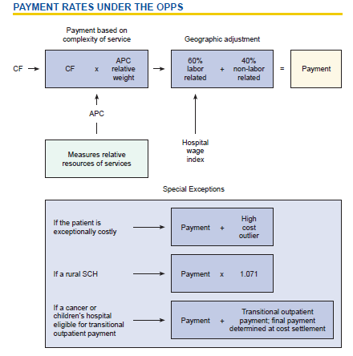
Calculation of Average Total Payments

Slide 8
Exploration of Medicare Outpatient Charge Data 2016
stats | Comprehensive APC Services | Average Estimated Total Submitted Charges (In US $) | Average Medicare Allowed Amount (In US $) | Average Medicare Payment Amount (In US $) | Outlier Comprehensive APC Services | Average Medicare Outlier Amount (In US $)
count | 27652.00 | 27652.00 | 27652.00 | 27652.00 | 17130.00 | 3387.00
mean | 101.38 | 41633.24 | 7755.54 | 6756.04 | 7.50 | 1550.50
std | 225.45 | 36341.61 | 6696.64 | 6508.88 | 30.15 | 1079.98
min | 11.00 | 214.43 | 105.81 | 101.96 | 0.00 | 137.63
25% | 19.00 | 18362.50 | 3557.55 | 2805.68 | 0.00 | 1016.61
50% | 37.00 | 29937.88 | 5010.95 | 3959.43 | 0.00 | 1293.52
75% | 85.00 | 52103.52 | 9000.21 | 7717.88 | 0.00 | 1727.71
max | 4959.00 | 512630.39 | 43837.58 | 42549.58 | 1067.00 | 18819.48

Slide 9
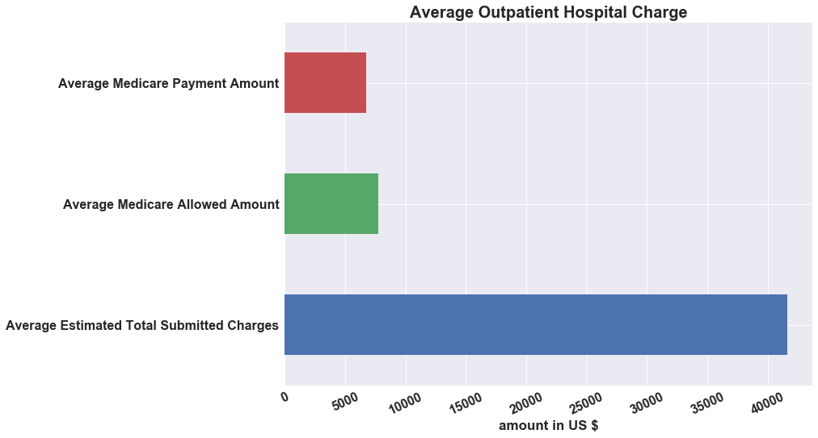
Submitted Charge vs Medicare Allowed Charges
Large gap between Medicare Allowed charges and what the Providers charge

Slide 10
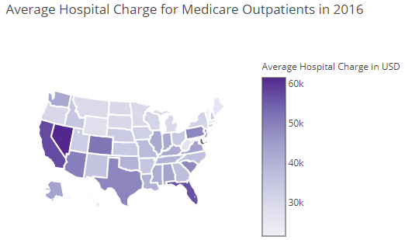
Average Charge By State for Medicare Outpatient
States Like Nevada, California and Florida charged highest in Average in 2016.

Slide 11
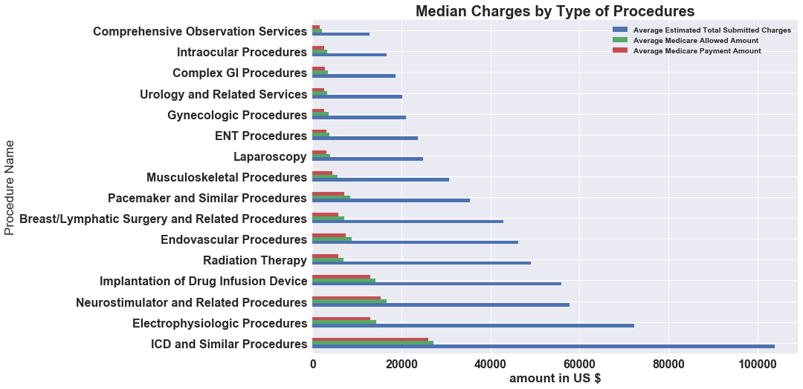
Median of Average Charge By Procedure Name
ICD and Related Procedures are the highest charged Procedures, Compressive Observation Services were least charged
ICD: Implantable Cardioverter Defibrillator Procedures and used to treat critical heart attack/failure.

Slide 12
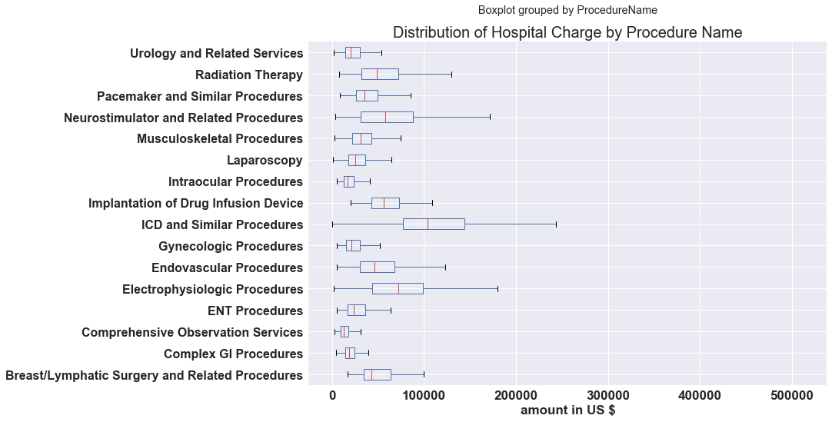
Distribution of Hospital Charge By Procedure Name
Highest Charged
Procedures like ICD, Electrophysiologic Procedures, and Neurostimulator and Related Procedures have the highest variations.
While least charged procedures have less variations

Slide 13
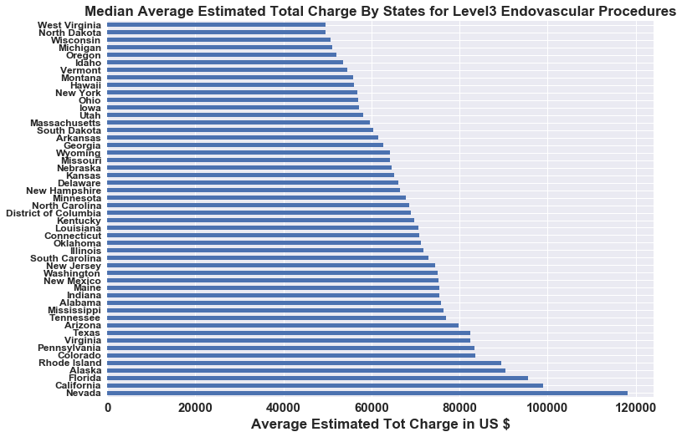
Median of Average Charge For Level 3 Endovascular Procedures
States Like Nevada ,California and Florida charged double of charges in lowest charging States.

Slide 14
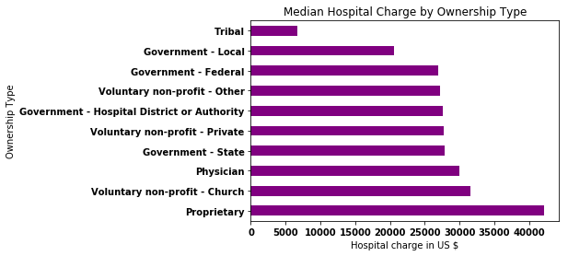
Hospital Charge by Hospital Ownership Type
Proprietary Hospitals charged the highest amount , Local Government Hospitals charged the lowest in average,
Federal Government and Voluntary non-profit hospitals charged comparable amount.

Slide 15
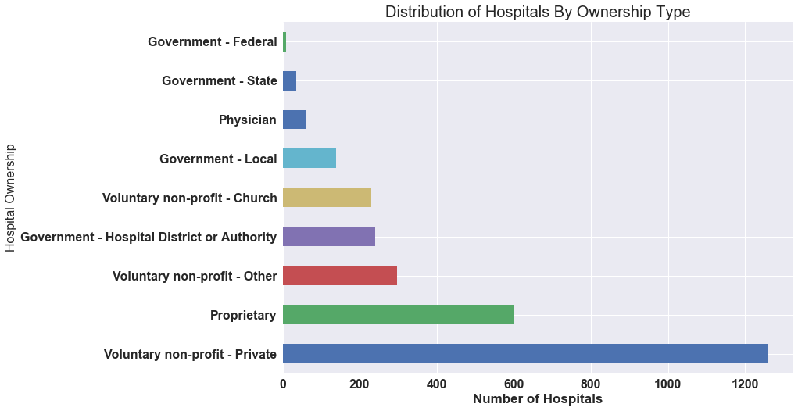
Number of Hospitals By Ownership Type
Over 1200 voluntary non-profit-private and followed by proprietary hospitals.

Slide 16
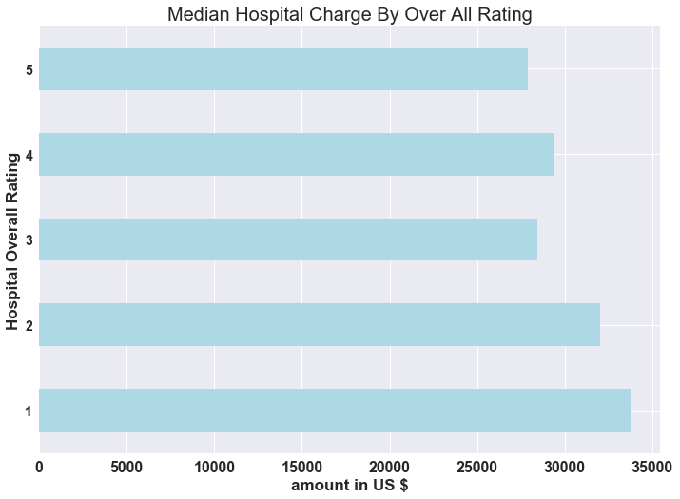
Median Charge by Level of Star
Lower Star Hospitals Higher Median Charge, Except Star-3

Slide 17
Test, Train data and Models
Data Grouped by County (1121 counties)
0.33 % Test Data
Target Variable: Mean of Average Submitted Hospital Charges
Features: % 65 and over, % African American, % Non-Hispanic White, Household Income, other to PCP Rate, %Uninsured Adults, % Uninsured children, # MV Deaths, #Drug Over Deaths, Drug Overdose Mortality Rate, % Limited Access to Healthy Foods, % Diabetic, % Rural.
Lasso Regression Model, Linear Regression ,Random Forest

Slide 18
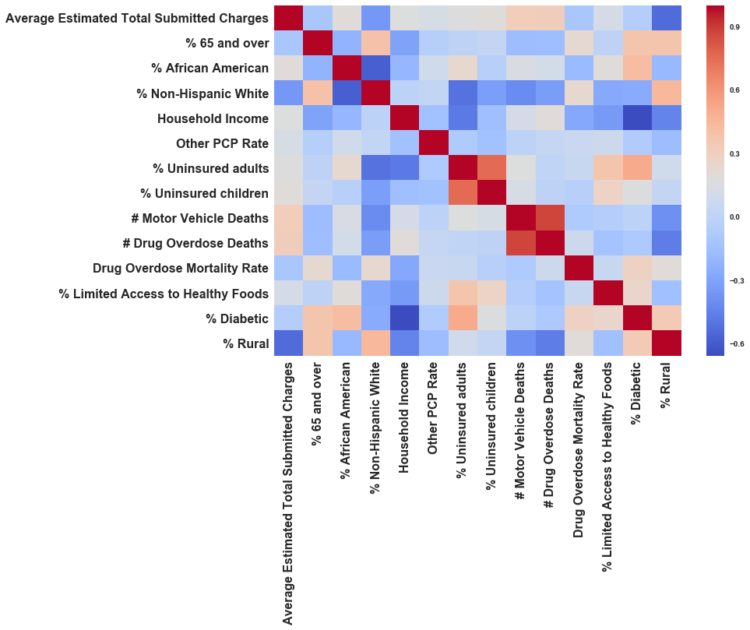
Correlation between Hospitals Charge and County Health Ranking Indicators

Slide 19
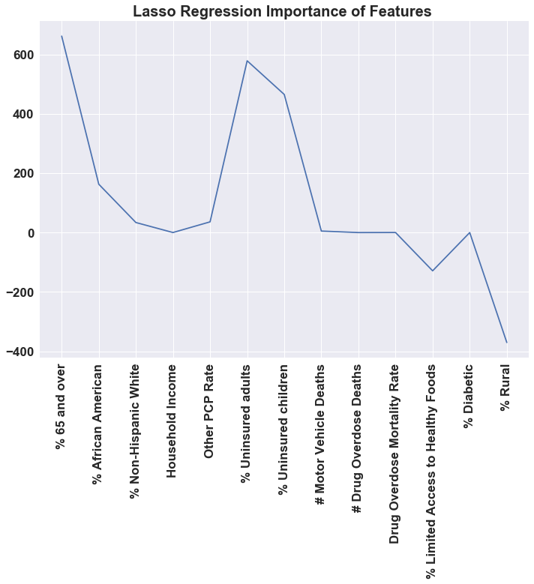
Lasso Regression Result
Lasso Regression didn’t drop any variables.

Slide 20
OLS Regression for Selected Variables
Only 35% of Hospital Charge variation is explained by these variables. This may confirm the Hospital charge mostly determined by market power of the hospitals (Administrative Decision)
Dep. Variable: Average Estimated Total Submitted Charges R-squared: 0.355
Model: OLS Adj. R-squared: 0.352
Method: Least Squares F-statistic: 122.8
Date: Sat, 11 May 2019 Prob (F-statistic): 0.000
features | coefficients | std err | T-stat | P>|t| | [0.025 0.975]
constant | 24360.000 | 2293.120 | 10.625 | 0.000 | 19900.000 | 28900.000
% Uninsured adults | 350.482 | 114.147 | 3.070 | 0.002 | 126.514 | 574.449
% Uninsured children | 623.635 | 229.121 | 2.722 | 0.007 | 174.078 | 1073.193
% 65 and over | 592.680 | 122.531 | 4.837 | 0.000 | 352.263 | 833.098
% Rural | -419.393 | 19.287 | -21.745 | 0.000 | -457.236 | -381.550
% African American | 131.048 | 39.052 | 3.356 | 0.001 | 54.424 | 207.672
Notes:
CDC data

Slide 21
Moving Forward
I will try to find market power indicators and include in the model(CCR data) to improve the goodness of fit for the models.

